Slide 1
GPS/Dead Reckoning Navigation with Kalman Filter Integration
Paul Bakker

Slide 2
Kalman Filter
“The Kalman Filter is an estimator for what is called the linear-quadratic problem, which is the problem of estimating the instantaneous ‘state’ of a linear dynamic system perturbed by white noise – by using measurements linearly related to the state but corrupted by white noise. The resulting estimator is statistically optimal with respect to any quadratic function of estimation error” [1]

Slide 3
Kalman Filter Uses
Estimation
  Estimating the State of Dynamic Systems
  Almost all systems have some dynamic component
Performance Analysis
  Determine how to best use a given set of sensors for modeling a system

Slide 4
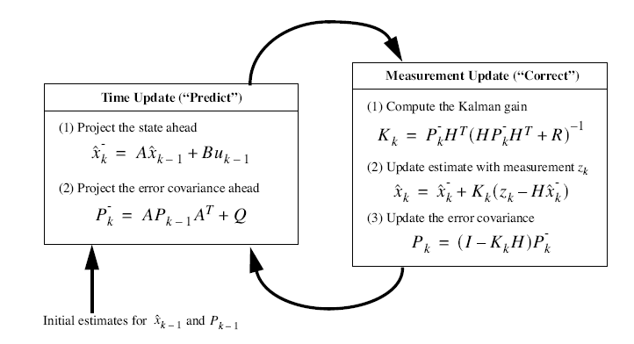
Basic Discrete Kalman Filter Equations
http://www.cs.unc.edu/~welch/media/pdf/kalman_intro.pdf

Slide 5
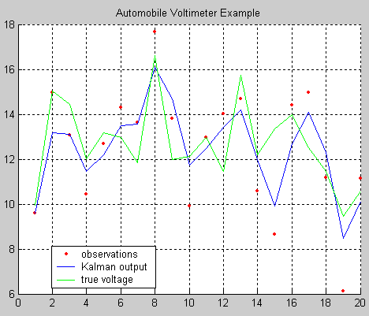
Automobile Voltimeter Example

Slide 6
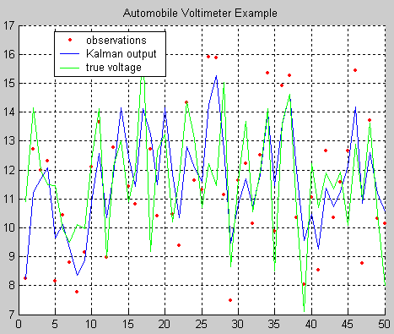
Time 50 Seconds

Slide 7
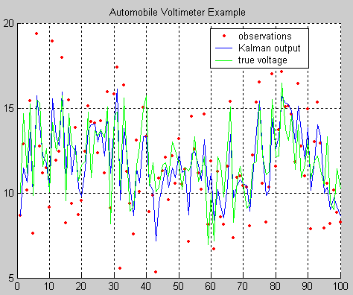
Time 100 Seconds

Slide 8
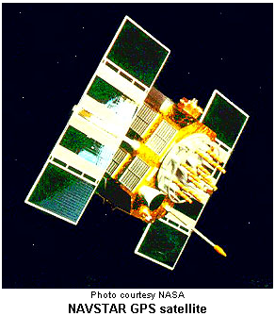
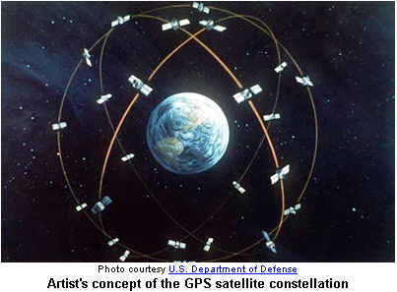
Global Positioning System

Slide 9
GPS
24 or more satellites (28 operational in 2000)
6 circular orbits containing 4 or more satellites
Radii of 26,560 and orbital period of 11.976 hours
Four or more satellites required to calculate user’s position

Slide 10

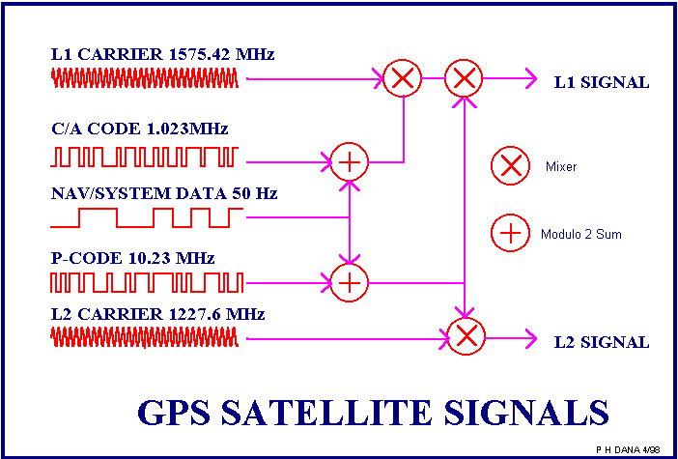
GPS Satellite Signals

Slide 11
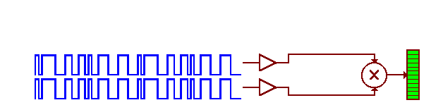
GPS code sync Animation
http://www.colorado.edu/geography/gcraft/notes/gps/gif/bitsanim.gif
When the Pseudo Random codes match up the receiver is in sync and can determine its distance from the satellite

Slide 12
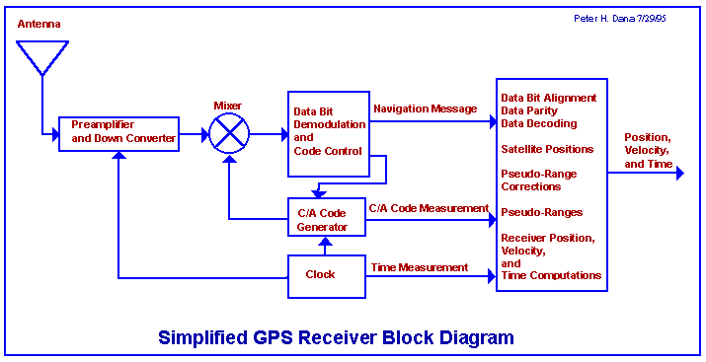
Receiver Block Diagram

Slide 13
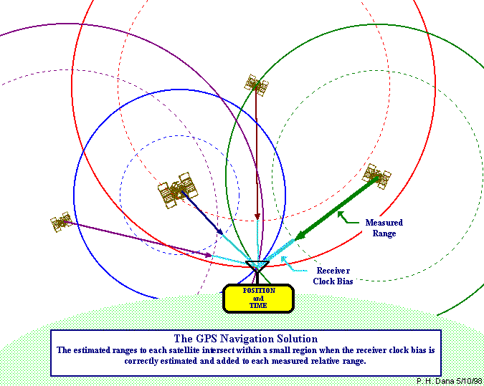
Navigation Pictorial

Slide 14
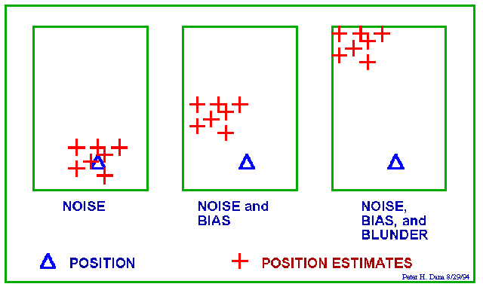
Position Estimates with Noise and Bias Influences

Slide 15
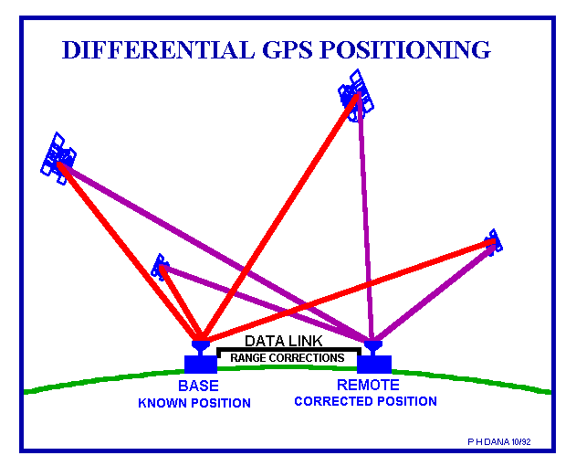
Differential GPS Concept
Reduce error by using a known ground reference and determining the error of the GPS signals
Then send this error information to receivers

Slide 16
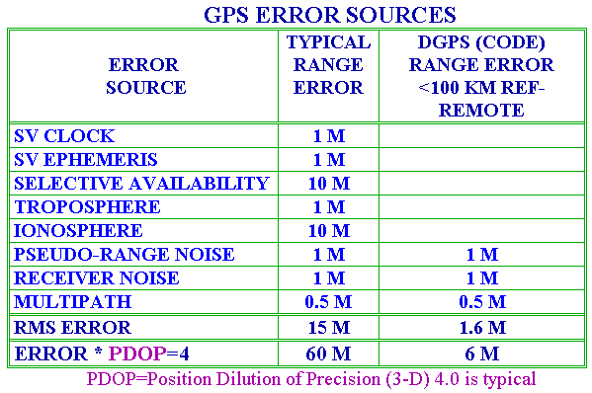
GPS Error Sources

Slide 17
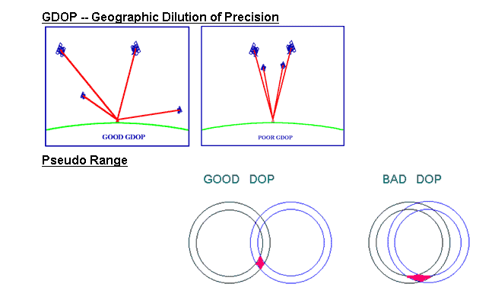
GDOP

Slide 18
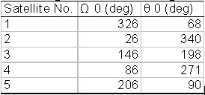
Example of Importance of Satellite Choice
The satellites are assumed to be at a 55 degree inclination angle and in a circular orbit
Satellites have orbital periods of 43,082
Right Ascension
Angular Location

Slide 19
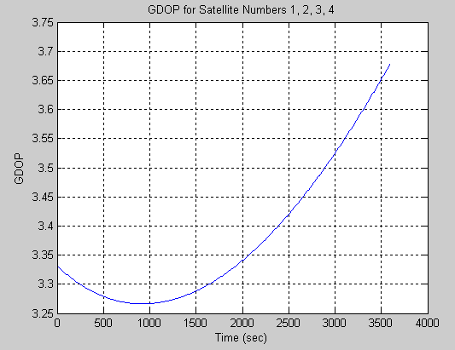
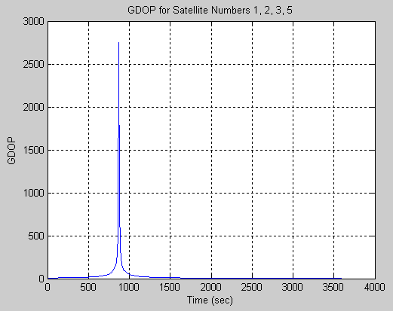
GDOP (1,2,3,4) vs. (1,2,3,5)
Optimum GDOP for the satellites
  The smaller the GDOP the better
“GDOP Chimney” (Bad) – 2 of the 4 satellites are too close to one another – don’t provide linearly independent equations

Slide 20
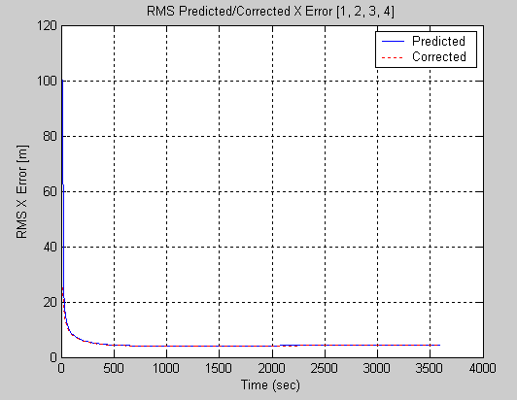
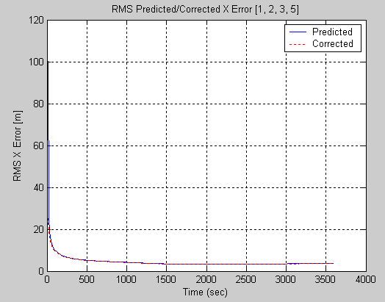
RMS X Error
Graphed above is the covariance analysis for RMS east position error
  Uses Riccati equations of a Kalman Filter
Optimal and Non-Optimal are similar

Slide 21
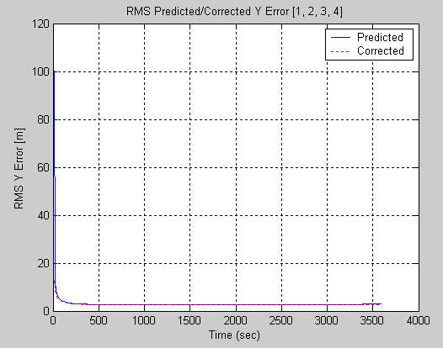
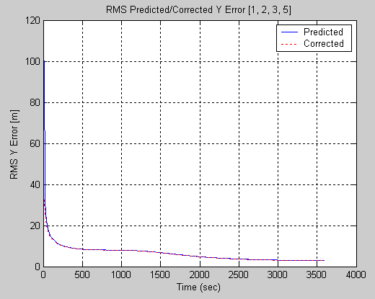
RMS Y Error
Covariance analysis for RMS north position error

Slide 22
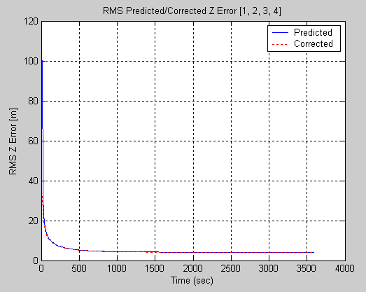
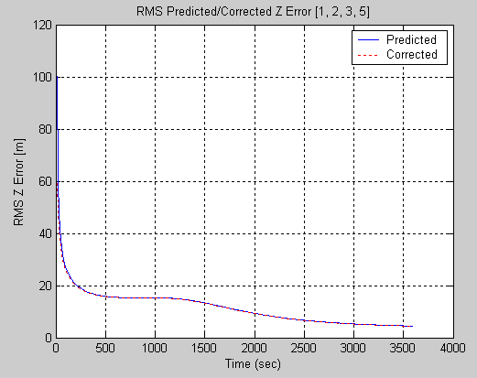
RMS Z Error
Covariance analysis for vertical position error

Slide 23
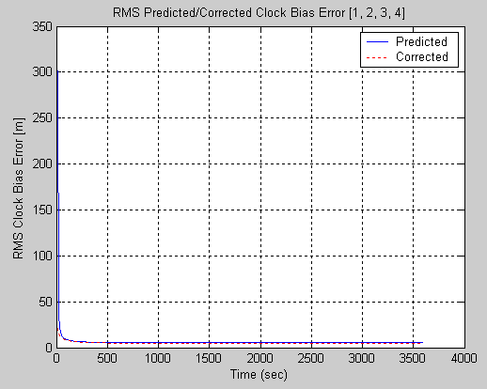
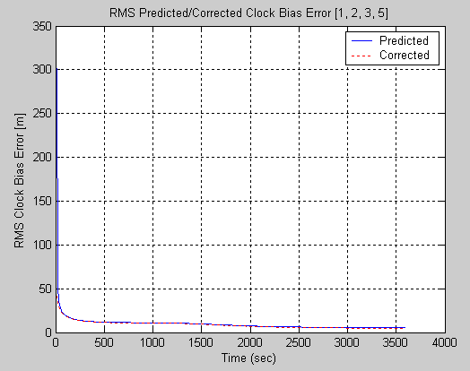
Clock Bias Error
Covariance analysis for Clock bias error

Slide 24
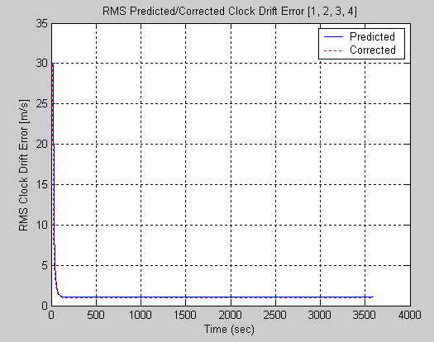
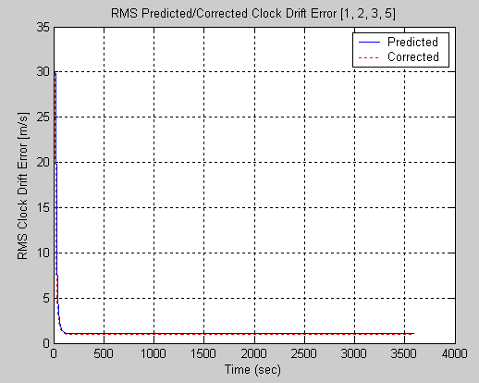
Clock Drift Error
Covariance analysis for Clock drift error

Slide 25
Questions & References
[1] M. S. Grewal, A. P. Andrews, Kalman Filtering, Theory and Practice Using MATLAB, New York: Wiley, 2001

